Slide 1
Used Car Price Prediction
KILL PROJECT
TEAM9 CSC DS

Slide 2
Introduction
- What is used car price prediction?
- Importance of predicting car prices accurately

Slide 3
TECHNOLOGIES USED
- PYTHON,
-HTML
-CSS
-MACHINELEARNING

Slide 4
Data Collection
- Sources: Kaggle, Used Car Websites, Dealerships
- Data Fields: Car Brand, Model, Year, Fuel Type, Transmission, Price, etc.

Slide 5
Data Preprocessing
- Handling missing values
- Encoding categorical variables
- Feature scaling

Slide 6
Machine Learning Models Used
- Linear Regression
- Decision Tree
- Random Forest
- Support Vector Machine (SVM)
- Neural Networks

Slide 7
Model Training & Evaluation
- Splitting data into training and testing sets
- Performance Metrics: RMSE, R-squared, MAE

Slide 8
Results & Analysis
- Best performing model
- Interpretation of results

Slide 9
Deployment
- Flask for web app development
- Hosting on cloud platforms

Slide 10
Conclusion & Future Scope
- Improvements using deep learning
- Adding more real-time features

Slide 11
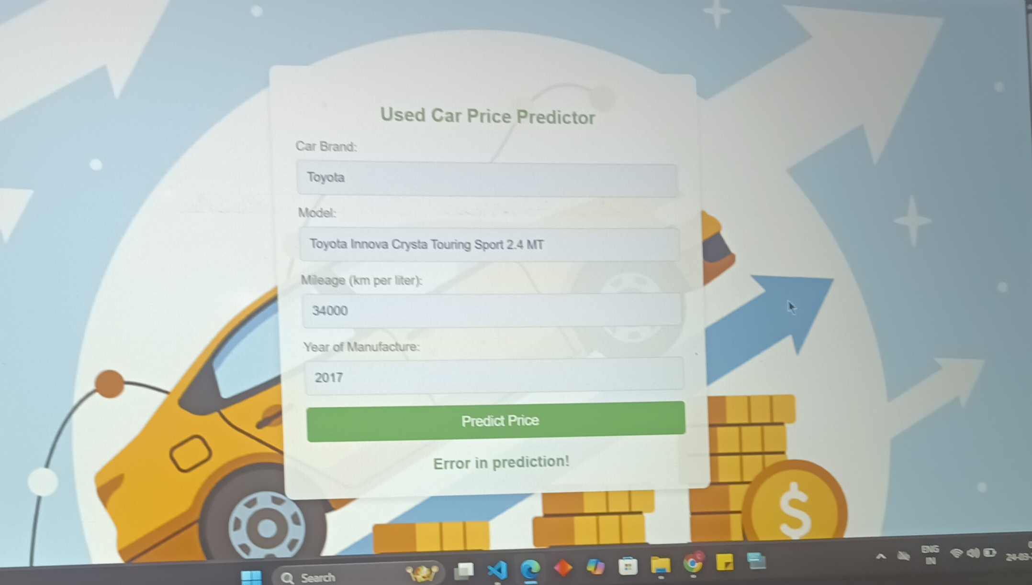
OVERVIEW

